Slide 1

Tata- Retail Store
Sara Novak
Notes:
Hello and welcome to this presentation about

Slide 2
Today‘s Agenda
Project Recap
Problem
Process
Insights
Summary

Slide 3

Project Recap
Online retail store want to review their data and provide insights that would be valuable to the CEO and CMO of the business. The aim was to analyse the major contributing factors to the revenue so that the management can plan strategically for the next year.

Slide 4

problem
The leadership was interested in seeking guidance into areas that are performing well so that they can keep a clear focus on what’s working. They were also interested in viewing different metrics based on the demographic information available in the data.

Slide 5
Proces
Data Understanding
Data Cleaning
Data Modeling
Data Analyzing
Presenting Insights
Notes:
We clean the negative quantities and there are unit prices that contains error. And We add Revenue new column
After cleaning using Tableau for our visualisation

Slide 6
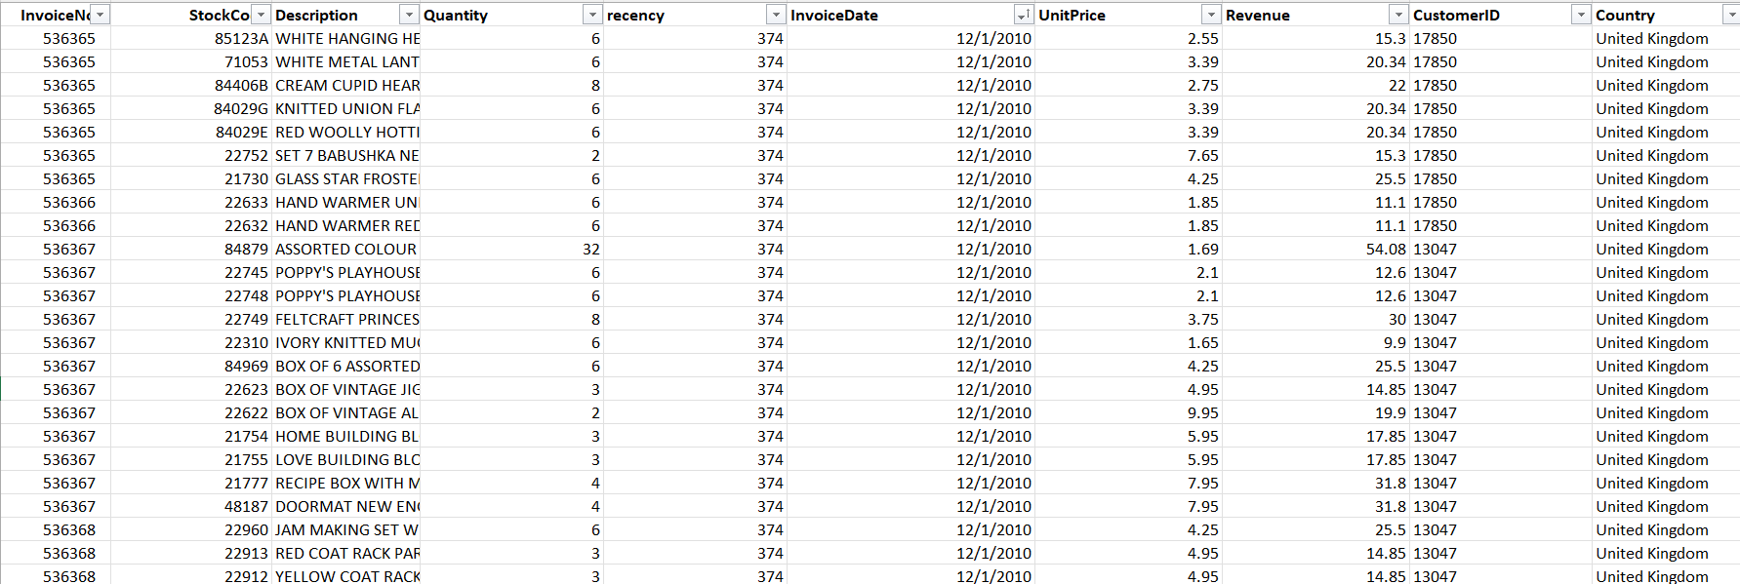
Notes:
10

Slide 7

Insights

Slide 8
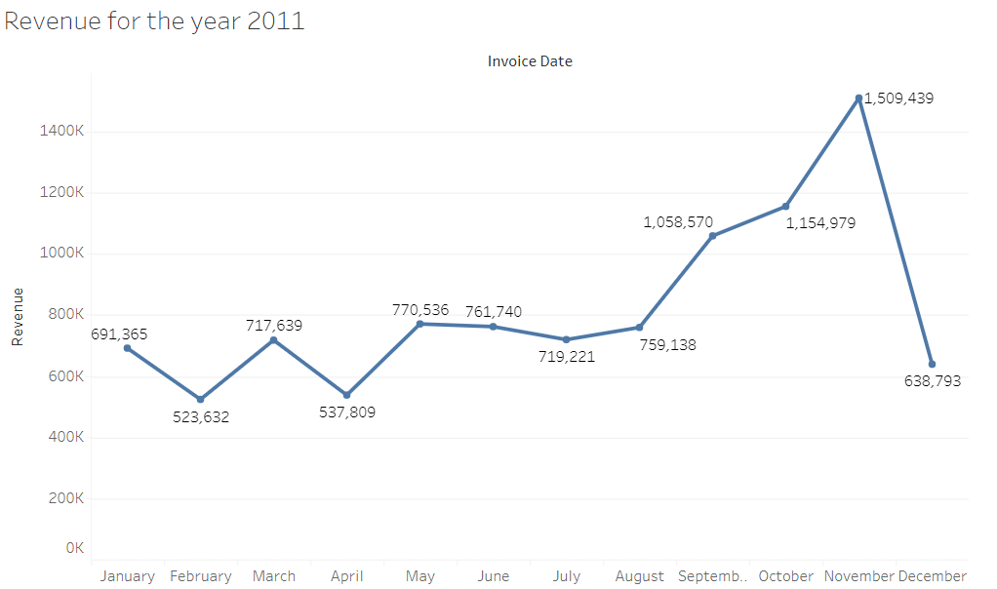
Question 1 The CEO of the retail store is interested to view the time series of the revenue data for the year 2011 only.
Notes:
We found that the revenue for the online retail store was highest in November, followed by August to October. The revenue then decreased in December but started increasing again in January.

Slide 9
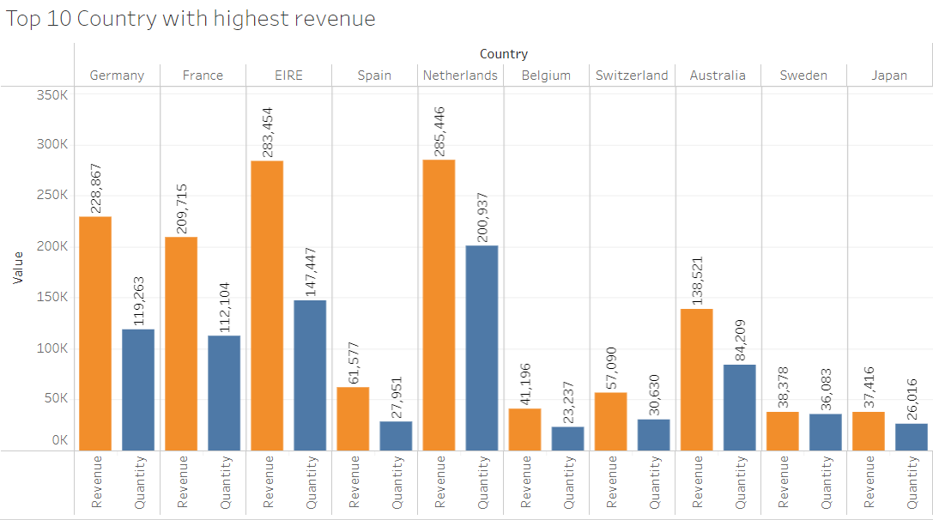
Question 2 The CMO is interested in viewing the top 10 countries which are generating the highest revenue. Additionally, the CMO is also interested in viewing the quantity sold along with the revenue generated.
Notes:
We found that the Netherlands, EIRE, and Germany are the countries generating the most revenue, along with high quantities sold. The United Kingdom was not included in the visual as per the CMO's request.

Slide 10
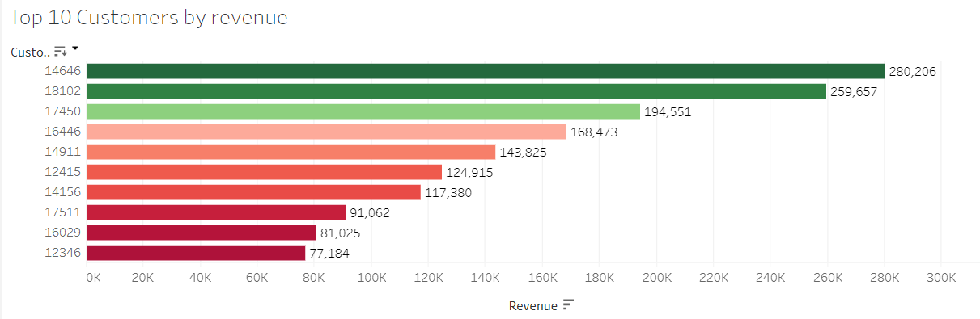
Question 3 The CMO of the online retail store wants to view the information on the top 10 customers by revenue.
Notes:
We found that the first three customers are generating the most revenue, with a revenue range from 195,473 to 280,206. The remaining customers have significantly lower revenue generation.

Slide 11
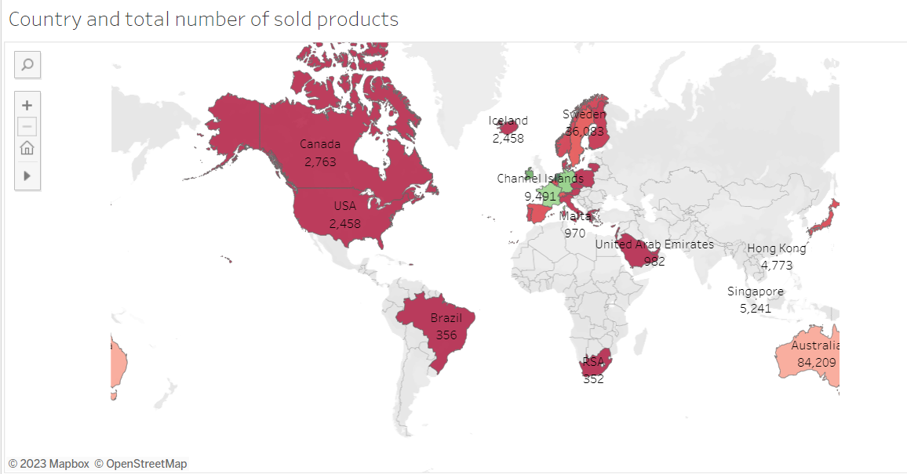
Question 4 The CEO is looking to gain insights on the demand for their products. He wants to look at all countries and see which regions have the greatest demand for their products.
Notes:
We found that Europe has the greatest demand for the products based on the data. We provided a visual that shows the demand for products in each country without including the United Kingdom.

Slide 12
Insights
We found that the revenue for the online retail store was highest in November, followed by August to October. The revenue then decreased in December but started increasing again in January.
We found that the Netherlands, EIRE, and Germany are the countries generating the most revenue, along with high quantities sold. The United Kingdom was not included in the visual as per the CMO's request.
We found that the first three customers are generating the most revenue, with a revenue range from 195,473 to 280,206. The remaining customers have significantly lower revenue generation.
We found that Europe has the greatest demand for the products based on the data. We provided a visual that shows the demand for products in each country without including the United Kingdom.

Slide 13
Summary
Based on our analysis, we found that the online retail store's revenue is seasonal, with higher revenue generated during the holiday season. We also identified the top-performing countries and customers, which could be targeted for expansion and retention strategies. We provided a visual for the demand for products in different countries, which could help the CEO in expansion planning.

Slide 14


Thank you
Notes:
Thank you for listening to this presentation. If you have any questions or would like to learn more about our engagement with Social Buzz, please feel free to ask.

